Slide 1

Operating Systems and Linux Programming - M23DE0105
MCA Sem I - Academic Year : 2024 - 2025 ODD Semester

Slide 2
Lecture - 1

Slide 3
AGENDA
Introduction
Quick look at Syllabus – Unit 3
Introduction to Linux Operating System

Slide 4

Quick Look at the Syllabus
Unit 3: Introduction with shell and Desktop to Linux
Introduction and interacting with shell and Desktop to Linux: History, salient features, Linux system architecture, Linux command format, Linux internal and external commands, Directory commands, File related commands, Disk related commands.
The Linux Shell Basic commands cls, cat, cal, date, calendar, who, printf, tty, sty, uname, passwd, echo, tput, bc, script, Introduction to Shell Scripting, read, Command Line Arguments, Exit Status of a Command.
shell types, shell script features, executing a shell script, system and user-defined variables, expr command, command substitution, escape sequence characters, shell script arguments, positional parameters, test command, file test, string test, numeric test
08

Slide 5
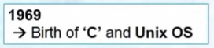

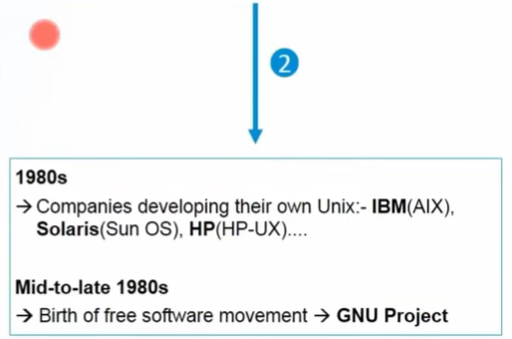
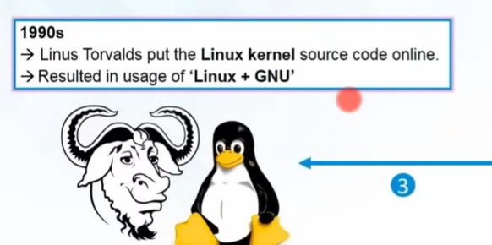
Introduction
Dennis Ritchie and Ken Thompson
AT&T Bell Labs
Open Source – Freely available to be used by anyone
Linux Distributions:
Ubuntu, Red Hat
Centos, Debian, Fedora
Richard Stallman – GNU Project (Gnu's Not Unix)
GNU = OS for free
Linux = Kernel of the OS
02

Slide 6
Introduction
Linux Definition
Linux is an open-source operating system developed by Linus Torvalds in 1991.
It provides a customizable and secure alternative to proprietary systems.
Its stable performance makes Linux widely used across devices, from personal computers to servers and smartphones.
The collaborative efforts of its developer community continue to drive innovation, making Linux a dominant force in the world of computing.
02

Slide 7
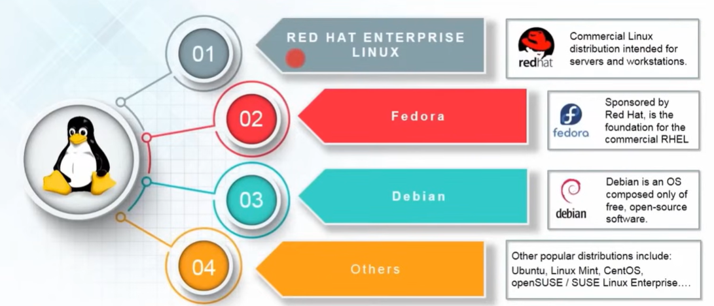
Linux Distributions
02

Slide 8
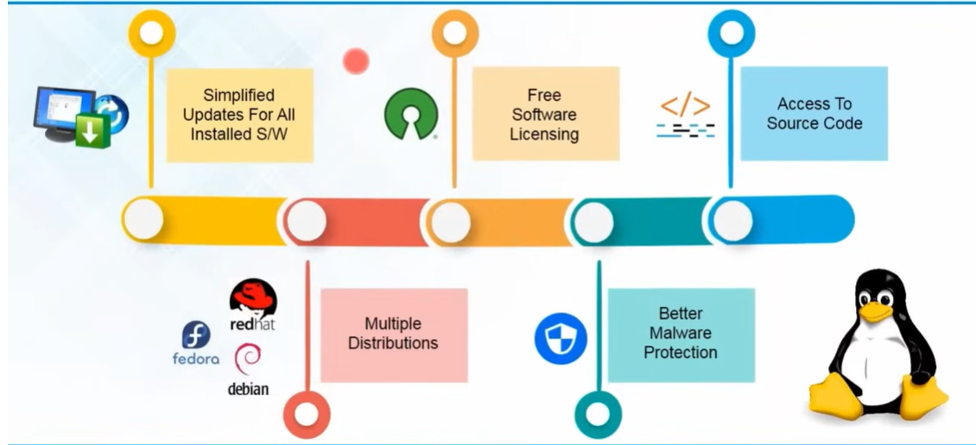
Linux Feature’s
02

Slide 9
Linux Feature’s
Multiuser capability: it supports multiple users. Multiple users can access the same system resources like memory, hard disk, etc. But they have to use different terminals to operate.
Multitasking: More than one function can be performed simultaneously by dividing the CPU time intelligently.
Portability: Portability doesn't mean it is smaller in file size or can be carried in pen drives or memory cards. It means that it supports different types of hardware.
02

Slide 10
Linux Feature’s
Security: It provides security in three ways namely authenticating (by assigning a password and login ID), authorization or file protection (by assigning permission to read, write, and execute), and encryption (converting file into an unreadable format).
Communication: is highly effective in Linux. it can be established between users working on different terminals connected to the same machine or different machines.
Organized file system: Linux treats everything including memory and I/O devices as files. The Linux filesystem allows easy and efficient maintenance of files and directories.
Support's customized keyboard: As it is used worldwide, it supports different language keyboards.
02

Slide 11
Lecture - 2

Slide 12
Recap
Introduction
Quick look at Syllabus – Unit 3
Introduction to Linux Operating System

Slide 13
AGENDA
Linux Architecture
Internal and External Commands

Slide 14
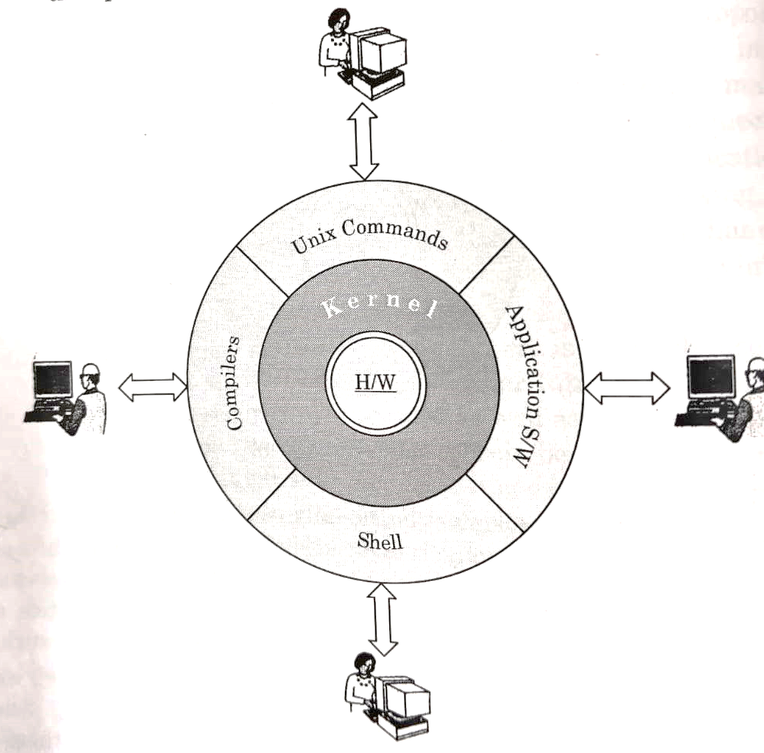
Linux System Architecture
The Linux Operating System's architecture primarily has these components:
Hardware layer
Kernel
Shell, and
System Utility
02

Slide 15
Linux System Architecture
Hardware layer
The Hardware Layer encompasses all the physical components of the computer, such as RAM (Random Access Memory), HDD (Hard Disk Drive), CPU (Central Processing Unit), and input/output devices.
This layer is responsible for interacting with the Linux Operating System and providing the necessary resources for the system and applications to function properly.
The Linux kernel and system libraries enable communication and control over these hardware components, ensuring they work harmoniously.
02

Slide 16
Linux System Architecture
2. Kernel
Kernel is the core part of Linux.
It is a collection of programs and routines written in C.
It is responsible for all major activities of the operating system.
It consists of various modules and interacts directly with the underlying hardware.
Kernel provides the required abstraction to hide low-level hardware details in system or application programs.
02

Slide 17
Linux System Architecture
2. Kernel
Functions of kernel are:
File management
Process management
Memory Management
Interprocess communication
02

Slide 18
Linux System Architecture
2. Kernel
It virtualizes the common hardware resources of the computer to provide each process with its virtual resources.
This makes the process seem the sole process running on the machine.
It is also responsible for preventing and mitigating conflicts between different processes.
02

Slide 19
Linux System Architecture
2. Kernel
Different types of the kernel are:
Monolithic Kernel
Hybrid kernels
Exo kernels
Micro kernels
02

Slide 20
Linux System Architecture
3. Shell
The shell is the user interface of the Linux Operating System.
It allows users to interact with the system by entering commands, which the shell interprets and executes.
The shell serves as a bridge between the user and the kernel, forwarding the user’s requests to the kernel for processing.
It provides a convenient way for users to perform various tasks, such as running programs, managing files, and configuring the system.
02

Slide 21
Linux System Architecture
4. System Utilities
System utilities are essential tools and programs provided by the Linux Operating System to manage and configure various aspects of the system.
These utilities perform tasks such as installing software, configuring network settings, monitoring system performance, managing users and permissions, and much more.
System utilities simplify system administration tasks, making it easier for users to maintain their Linux systems efficiently.
02

Slide 22
Linux System Architecture
5. System Library
Linux uses system libraries, also known as shared libraries, to implement various functions of the operating system.
These libraries contain pre-written code that applications can use to perform specific tasks.
By using these libraries, developers can save time and effort, as they don’t need to write the same code repeatedly.
System libraries act as an interface between applications and the kernel, providing a standardized and efficient way for applications to interact with the underlying system.
02

Slide 23
Linux - Advantages
It is an open-source operating system.
It is more secure than any other operating system.
Various Linux distributions are available so that you can use them according to your requirements or according to your taste.
Linux is freely available to use on the internet.
It has large community support.
It provides high stability. It rarely slows down or freezes and there is no need to reboot it after a short time.
It maintains the privacy of the user.
02

Slide 24
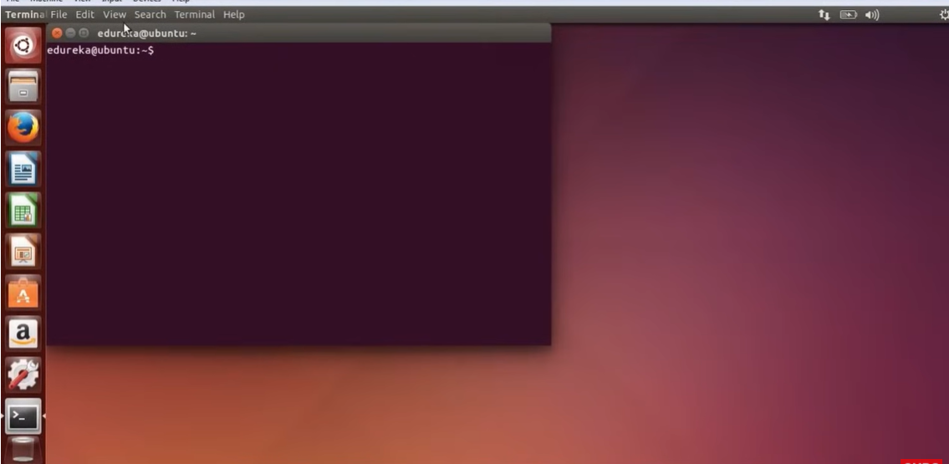
Linux Command Format
02

Slide 25
Linux Internal and External Command
In Linux, commands can be categorized into two types:
Internal (built-in) commands and
External commands.
Understanding the distinction between them helps in knowing how the system executes and manages them.
02

Slide 26
Linux Internal and External Command
Internal Commands
Internal commands are built into the shell itself.
They are part of the shell's executable code, which means they are loaded into memory when the shell starts.
Internal commands execute more quickly because they do not require loading an external executable file from the disk.
02

Slide 27
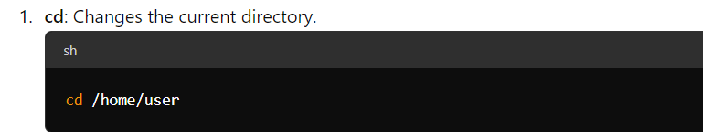
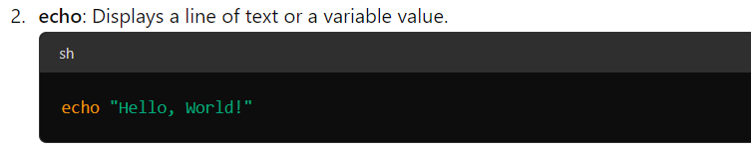
Linux Internal and External Command
Internal Commands
Examples of Internal Commands
02

Slide 28
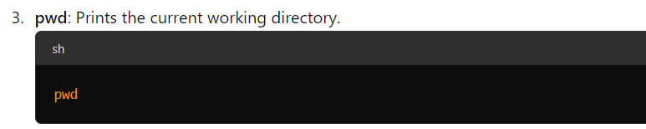
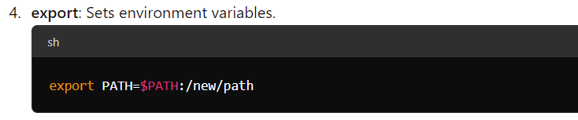
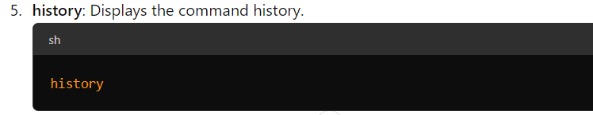
Linux Internal and External Command
Internal Commands
Examples of Internal Commands
02

Slide 29
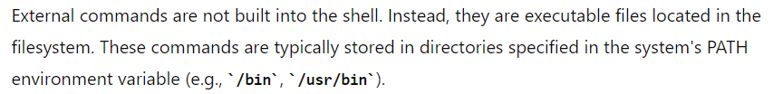
Linux Internal and External Command
External Commands
When you run an external command, the shell searches for the executable file in the directories listed in the PATH variable, loads it into memory, and then executes it.
02

Slide 30
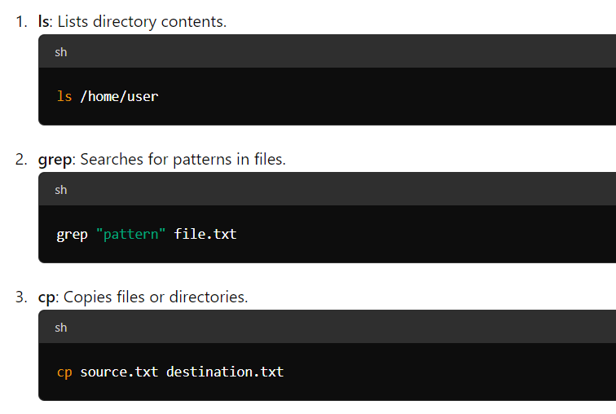
Linux Internal and External Command
External Commands
Examples of External Commands
02

Slide 31
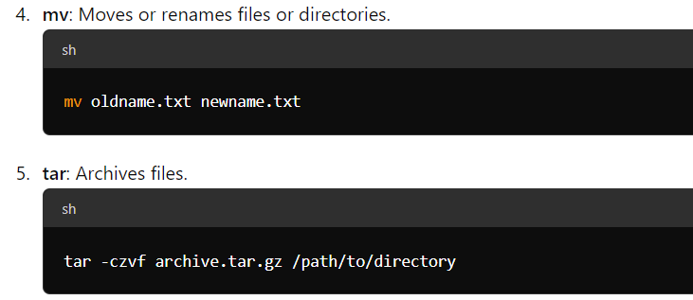
Linux Internal and External Command
External Commands
Examples of External Commands
02

Slide 32
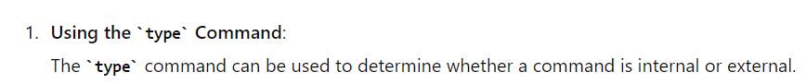
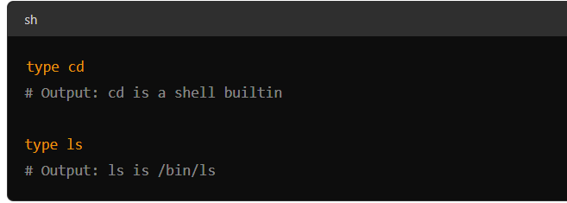
Linux Internal and External Command
How to Identify Internal and External Commands
02

Slide 33
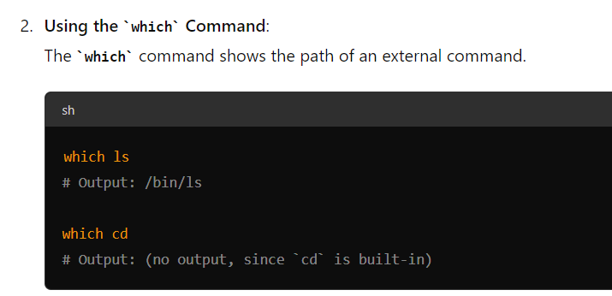
Linux Internal and External Command
How to Identify Internal and External Commands
02

Slide 34
Lecture - 3

Slide 35
Recap
Linux Architecture
Internal and External Commands

Slide 36
AGENDA
Directory Commands
File Related Commands
Disk Related Commands
The Linux Shell Basic Commands

Slide 37
Directory Commands
Directory commands in Linux are used to navigate, manage, and manipulate directories in the filesystem.
These commands are essential for organizing files and directories, exploring directory contents, and maintaining the directory structure.
Here are some of the most commonly used directory commands:
02

Slide 38
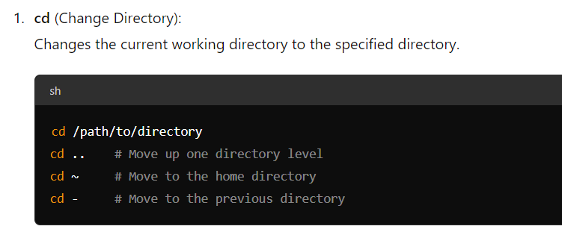
Directory Commands
Navigating Directories
02

Slide 39
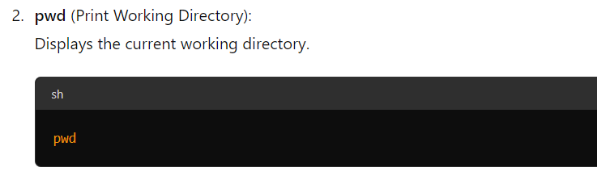
Directory Commands
Navigating Directories
02

Slide 40
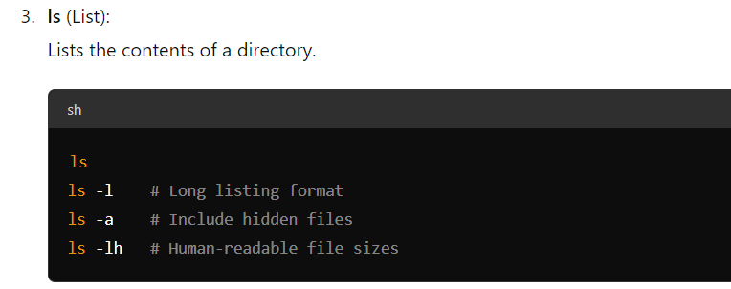
Directory Commands
Listing and Viewing Directory Contents
02

Slide 41
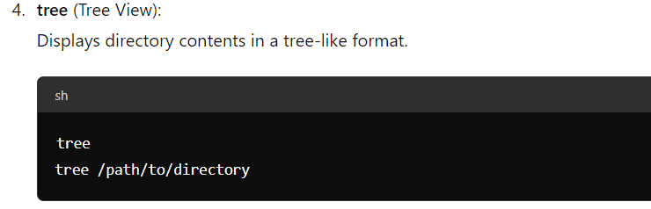
Directory Commands
Listing and Viewing Directory Contents
02

Slide 42
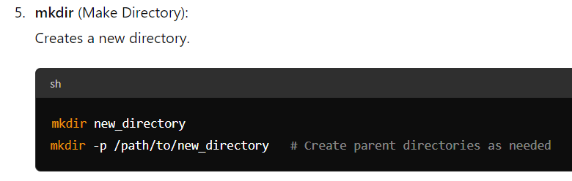
Directory Commands
Creating and Removing Directories
02

Slide 43
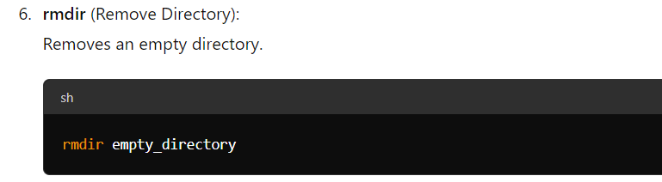
Directory Commands
Creating and Removing Directories
02

Slide 44
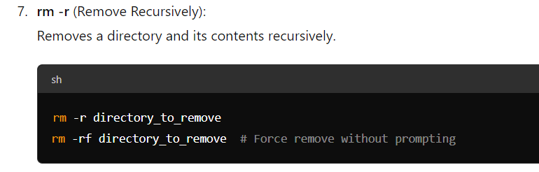
Directory Commands
Creating and Removing Directories
02

Slide 45
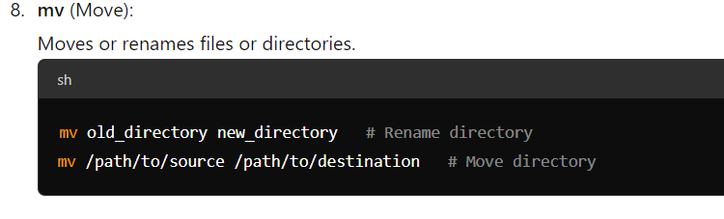
Directory Commands
Moving and Renaming Directories
02

Slide 46
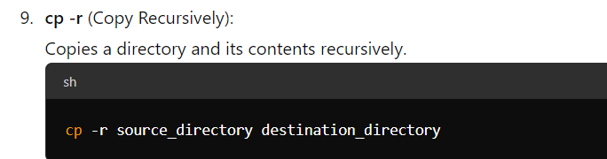
Directory Commands
Copying Directories
02

Slide 47
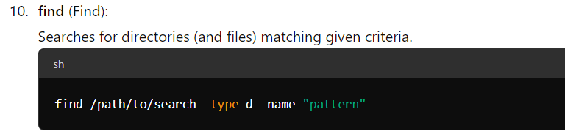
Directory Commands
Finding Directories
02

Slide 48
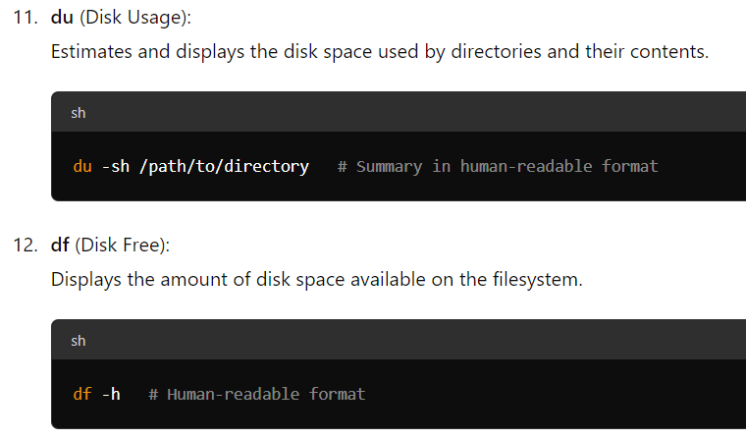
Directory Commands
Other Useful Directory Commands
02

Slide 49
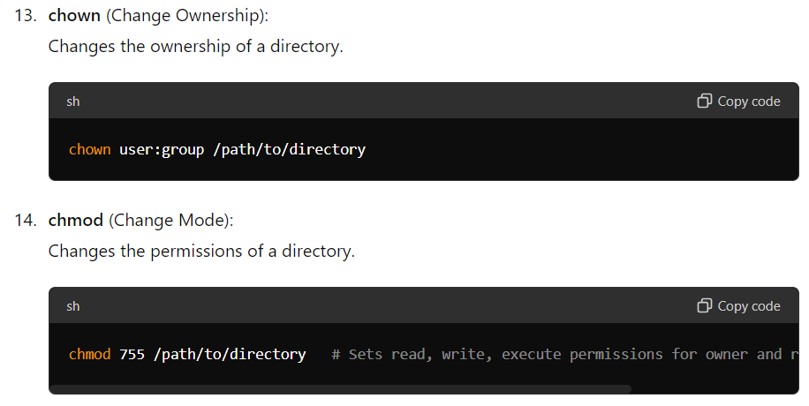
Directory Commands
Other Useful Directory Commands
02

Slide 50
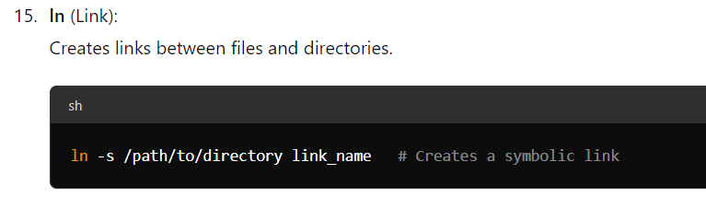
Directory Commands
Other Useful Directory Commands
02

Slide 51
File Related Commands
Here are some common file-related commands in Linux along with brief descriptions:
Create a File :
cat > filename.txt
My First Linux Program
After running this command, type your content, then press Ctrl + D to save and exit.
cat filename
My First Linux Program
02

Slide 52
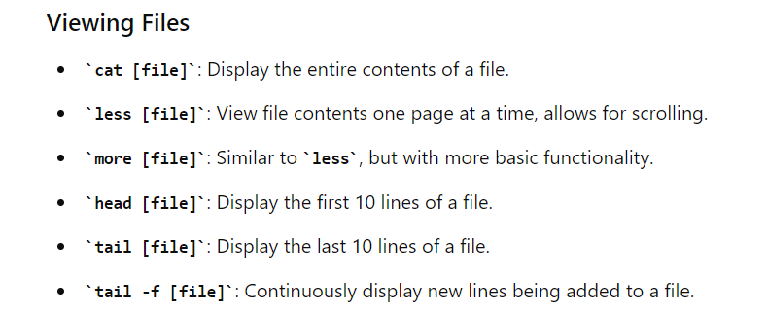
File Related Commands
Here are some common file-related commands in Linux along with brief descriptions:
02

Slide 53
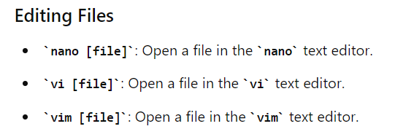
File Related Commands
Here are some common file-related commands in Linux along with brief descriptions:
02

Slide 54
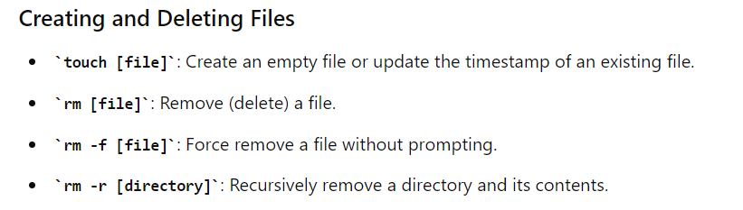
File Related Commands
Here are some common file-related commands in Linux along with brief descriptions:
02

Slide 55
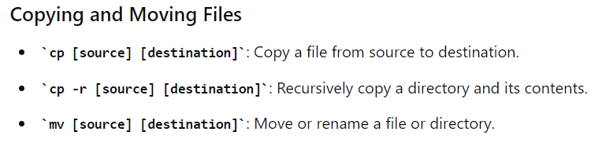
File Related Commands
Here are some common file-related commands in Linux along with brief descriptions:
02

Slide 56
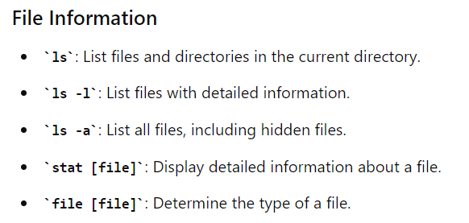
File Related Commands
Here are some common file-related commands in Linux along with brief descriptions:
02

Slide 57
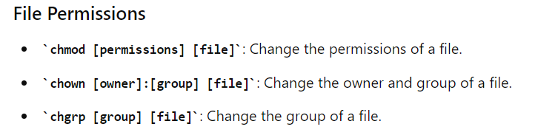
File Related Commands
Here are some common file-related commands in Linux along with brief descriptions:
02

Slide 58
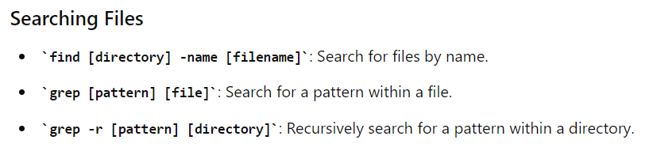
File Related Commands
Here are some common file-related commands in Linux along with brief descriptions:
02

Slide 59
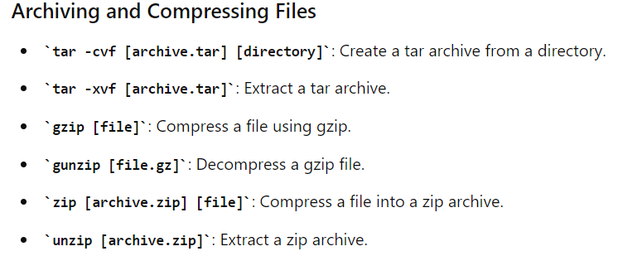
File Related Commands
Here are some common file-related commands in Linux along with brief descriptions:
02

Slide 60
File Related Commands
Here are some common file-related commands in Linux along with brief descriptions:
02

Slide 61
Lecture - 4

Slide 62
Recap
Directory Commands
File Related Commands

Slide 63
AGENDA
Disk Related Commands
The Linux Shell Basic Commands

Slide 64
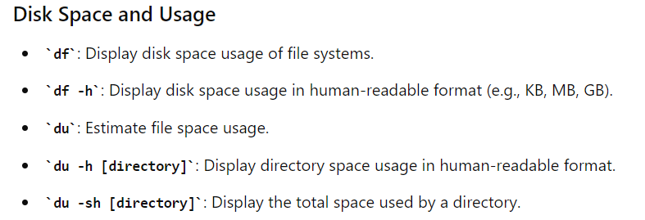
Disk Related Commands
Here are some common disk-related commands in Linux along with brief descriptions:
02

Slide 65
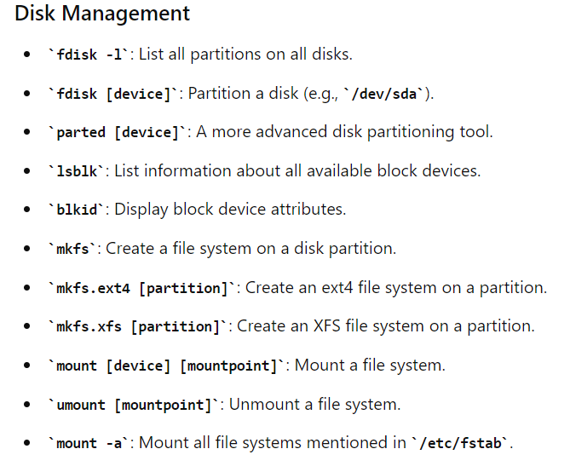
Disk Related Commands
Here are some common disk-related commands in Linux along with brief descriptions:
02

Slide 66
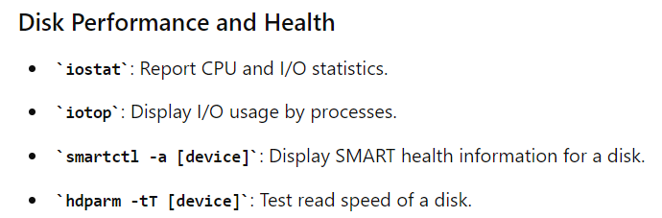
Disk Related Commands
Here are some common disk-related commands in Linux along with brief descriptions:
02

Slide 67
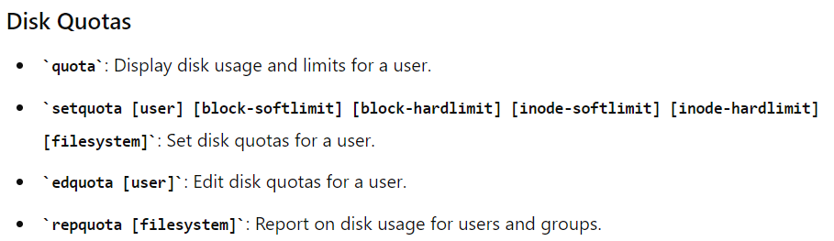
Disk Related Commands
Here are some common disk-related commands in Linux along with brief descriptions:
02

Slide 68
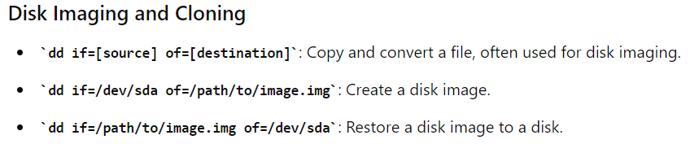
Disk Related Commands
Here are some common disk-related commands in Linux along with brief descriptions:
02

Slide 69
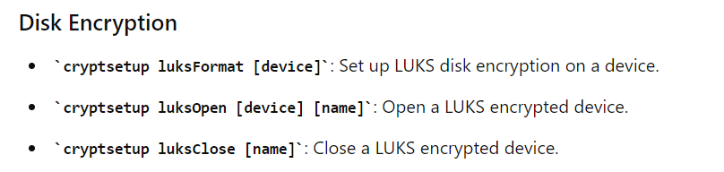
Disk Related Commands
Here are some common disk-related commands in Linux along with brief descriptions:
02

Slide 70
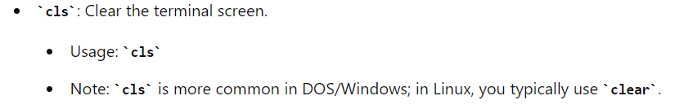
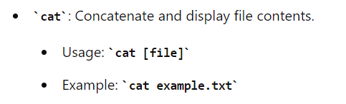
The Linux Shell Basic command
02

Slide 71
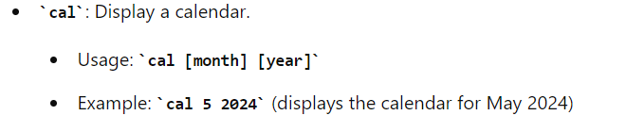
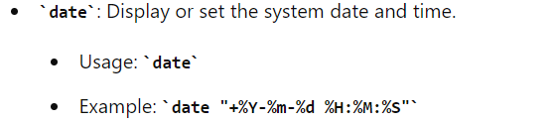
The Linux Shell Basic command
02

Slide 72
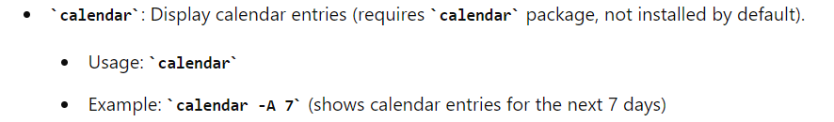

The Linux Shell Basic command
02

Slide 73


The Linux Shell Basic command
02

Slide 74


The Linux Shell Basic command
02

Slide 75


The Linux Shell Basic command
02

Slide 76


The Linux Shell Basic command
02

Slide 77

The Linux Shell Basic command
02

Slide 78
Lecture - 5

Slide 79
Recap
Disk Related Commands
The Linux Shell Basic Commands

Slide 80
AGENDA
Introduction to Shell Scripting

Slide 81
Introduction to Shell Scripting
Shell
A Shell is a program that sits on the Kernel and acts as an agent or interface between the users and the kernel and hence the hardware.
It is similar to the command.com in the MS-DOS environment
A Shell is a command interpreter or a processor.
As soon as the system is booted successfully, the shell presents a command line prompt (usually a $ or % symbol) at which the user can type in any Linux command.
02

Slide 82
Introduction to Shell Scripting
Shell
After accepting the command, the shell generates a readily executable simple command line by parsing it, evaluating variables, performs command substitution, interprets meta characters like * or ? And identifies the PATH.
This simple command line is then passed onto the kernel for execution.
In addition, the shell also has certain programming capability of its own.
Using this capability, programs called shell programs can be written called as shell scripts
02

Slide 83
Introduction to Shell Scripting
Shell Types
There are different types of shells available:
The Bourne Shell (sh)
The C Shell (csh)
The Korn Shell (ksh)
The Bourne-Again Shell (bash)
02

Slide 84
Introduction to Shell Scripting
Shell Types
The Bourne Shell (sh)
The most common shell available in Linux and the first major shell to be developed.
It has been named after its author, Stephen Bourne at At & T Bell Labs.
This shell is distributed as the standard shell on almost all Linux systems.
02

Slide 85
Introduction to Shell Scripting
Shell Types
2. The C Shell (csh)
Bill Joy developed this shell.
It is called C Shell because its syntax and usage is similar to C Programming Language. Not available on all machines.
Shell Scripts written on C Shell are not compatible with the Bourne shell.
A major advantage over the Bourne shell is its capability to execute processes in the background.
A version of this shell called tcsh is available free of cost under Linux.
02

Slide 86

Introduction to Shell Scripting
Shell Types
3. The korn Shell (ksh)
02

Slide 87
Introduction to Shell Scripting
Shell Types
4. The Bourne-Again Shell (bash)
02

Slide 88
Introduction to Shell Scripting
Shell as a Command Processor
02

Slide 89
Introduction to Shell Scripting
Shell as a Command Processor
02

Slide 90

Introduction to Shell Scripting
The Shell Prompt
02

Slide 91
Introduction to Shell Scripting
The Shell Prompt
02

Slide 92

Introduction to Shell Scripting
Commands in Linux – General Features
02

Slide 93

Introduction to Shell Scripting
Commands in Linux – General Features
02

Slide 94


Introduction to Shell Scripting
Commands in Linux – General Features
02

Slide 95

Introduction to Shell Scripting
Commands in Linux – General Features
02

Slide 96

Basic Commands
02

Slide 97
Basic Commands
02

Slide 98

Basic Commands
02

Slide 99
Basic Commands
02

Slide 100

Basic Commands
02

Slide 101

Basic Commands
02

Slide 102

Basic Commands
02

Slide 103

Basic Commands
02

Slide 104
Basic Commands
02

Slide 105

Basic Commands
02

Slide 106
Basic Commands
02

Slide 107

Basic Commands
02

Slide 108
Basic Commands
02

Slide 109
Basic Commands
02

Slide 110

Basic Commands
02

Slide 111

Basic Commands
02

Slide 112

Basic Commands
02

Slide 113
Basic Commands
02

Slide 114

Basic Commands
02

Slide 115
Basic Commands
02

Slide 116
Basic Commands
02

Slide 117
Basic Commands
02

Slide 118
Basic Commands
02

Slide 119

Basic Commands
02

Slide 120

Basic Commands
02

Slide 121

Basic Commands
02

Slide 122

Basic Commands
02

Slide 123

Basic Commands
02

Slide 124

Basic Commands
02

Slide 125

Basic Commands
02

Slide 126

Basic Commands
02

Slide 127
Basic Commands
02

Slide 128
Basic Commands
02

Slide 129

Basic Commands
02

Slide 130

Basic Commands
02

Slide 131
Basic Commands
02

Slide 132


Basic Commands
02

Slide 133

Basic Commands
02

Slide 134
Basic Commands
02

Slide 135
Basic Commands
02

Slide 136

Basic Commands
02

Slide 137

Basic Commands
02

Slide 138

Basic Commands
All misspelled words are displayed in alphabetical order
02

Slide 139
Basic Commands
02

Slide 140

Basic Commands
02

Slide 141
Basic Commands
02

Slide 142

Basic Commands
02

Slide 143
Basic Commands
02

Slide 144
Lecture - 6

Slide 145
Recap
Introduction to Shell Scripting

Slide 146
AGENDA
Shell Variables

Slide 147
Shell Variables
The Shell also has programming capabilities of its own.
A Shell can be considered as a programming language.
As with other languages, variables are defined and used within a shell.
Rules for constructing variable names are very similar to the rules used for constructing file names.
02

Slide 148
Shell Variables
Rules for constructing variable names
Variable names are constructed using only alphanumeric characters and the underscore(_) character with the first one being a letter.
The names are case-sensitive.
There are 3 types of Shell variables:
System Variables
Local Variables
User Defined Variables
Special Variables / Positional Parameters.
02

Slide 149
Shell Variables
System Variables
System variables are set during the boot sequence or immediately after logging in.
The working environment under which a user works, depends entirely upon the values of these variables.
These variables are also known as Environmental variables.
These are similar to Global variables in a general sense.
If required, values of these variables can be changed to have an environment to suit the user.
02

Slide 150
Shell Variables
System Variables
By convention these variables are written using uppercase letters only.
Examples: PATH, HOME, IFS, MAIL, SHELL, TERM.
02

Slide 151
Shell Variables
System Variables - The PATH variable
The PATH variable holds a list of directories in a certain order.
In this list colons(:) separate different directories.
The current value of this variable can be seen using echo command.
Example:
$echo PATH
/usr/local/sbin:/usr/sbin:/usr/bin/X11:.
$
02

Slide 152
Shell Variables
System Variables - The PATH variable
When any command is given, the shell searches for its program in the directories listed in the PATH one by one.
In this case, it first searches in the /usr/local/sbin directory, next in the /usr/sbin directory, later in the /usr/bin/X11 directory and finally in the current directory because of the dot(.) in the end.
If the program for the command is not found in any of these directories the message command not found will be displayed.
02

Slide 153
Shell Variables
System Variables - The HOME variable
When a user logs in he or she will be automatically placed in the HOME directory.
This directory is decided by the system administrator at the time of opening an account for the user and is stored in the file /etc/passwd.
The value of the path of the home directory is stored in the variable HOME.
The user can know this value using the echo command
$echo $HOME
/usr/mgv
$
02

Slide 154
Shell Variables
System Variables - The IFS variable
This variable holds tokens the shell commands use to parse a string into substrings such as a word.
The default tokens are the three whitespace tokens – space, tab, and newline.
Because all these are non-printable characters they can be seen or verified by using the od command.
02

Slide 155
Shell Variables
System Variables - The IFS variable
The first column of numbers shows the relative offset from the start of the input.
040 – the octal equivalent of the ASCII value of the space character.
011 – tab character
012 – newline character
Example:
$echo “$IFS” | od –bc
0000000 040 011 012 012
\t \n \n
0000004
The option –b displays the octal value of each character.
-c displays the character itself.
02

Slide 156
Shell Variables
System Variables - The MAIL variable
This variable holds the absolute pathname of the file where the user’s mail is kept.
Usually the name of this file is the User’s login name.
Typically, the value stored in this variable will be /usr/spool/mail/$LOGNAME
02

Slide 157
Shell Variables
System Variables - The SHELL variable
This variable contains the name of the users shell program in the form of absolute pathname.
The value of the variable SHELL may be known by using the echo command.
Example:
$echo $ SHELL
/bin/bash$
02

Slide 158
Shell Variables
Local Variables /User Defined Variables
Local variables in the shell are local to a particular user’s shell.
As specific users define and use these variables, they are also called user-defined variables.
These variables exist only briefly during the execution of a shell script.
They are local to the user’s shell environment and unavailable for the other scripts or processes.
02

Slide 159
Shell Variables
Local Variables /User Defined Variables
Rules for construction variable names
Shell variable names are constructed using only alphanumeric characters and the underscore (_) character, with the first one being a letter.
It’s case sensitive.
02

Slide 160
Shell Variables
Local Variables /User Defined Variables
Defining a shell variable
A shell variable is defined using an equal to (=) operator without any spaces on either side of it.
The general format of a variable definition is
variable=value
02

Slide 161
Shell Variables
Local Variables /User Defined Variables
Defining a shell variable
Examples
$x=37 #assigns 37 to x
$PS1=+ #changes the primary prompt to +
+TERM=vt100 #sets the terminal variable to vt100
+
02

Slide 162
Shell Variables
Local Variables /User Defined Variables
Type of a shell variable
All shell variables are of string type.
The value of the variables are stored in the ASCII format.
By default all shell variables are initialized as null strings.
Thus, while writing shell programs, it is unnecessary to type, declare, or initialize shell variables.
02

Slide 163
Shell Variables
Local Variables /User Defined Variables
Evaluating a shell variable
Shell variables are evaluated by prefixing the variable name with a $.
When the shell reads a command line, all words preceded by a $ are identified and evaluated as variables.
Example:
$x=37
$echo $x
37
$echo $xyz
$
02

Slide 164
Shell Variables
Local Variables /User Defined Variables
Variables are concatenated by placing them adjacent to each other.
Example:
$x=Venkatesh ; y=murthy
$z=$x$y
Venkateshmurthy
$
02

Slide 165
Shell Variables
The Export Command
With many shells, including the Bourne and Korn Shells, values of the variables set or changed in one program will not be available to other programs.
It is possible to make the values available across all programs or processes by using the export command.
In the bourne shell the following 2 statements make the value of TERM available to all programs.
$TERM=vt100
$export TERM
$
02

Slide 166
Shell Script
The set of commands taken together as a single unit within a file and executed at a stretch is called a shell program or shell script.
A shell script includes commands for selective execution (control commands), Commands for I/O operations, commands for repeated execution (loop-control structures) of a certain set of commands or statements, shell variables and other features.
02

Slide 167
Shell Script - Execution
Example
$cat my_script.sh
echo This is my first shell script.
echo Good Luck
$
02

Slide 168
Shell Script - Execution
Example
$sh my_script.sh
This is my first shell script.
Good Luck
$
02

Slide 169
The read command
The read command is used to give input to a shell program interactively.
This command reads just one line and assigns this line to one or more shell variables.
Example:
$cat readname.sh
echo what is your name\?
read name
echo The name is $name
$
02

Slide 170
The read command
Multiple Arguments:
The read command can take multiple arguments using a single read command.
Example
$read a b c
02

Slide 171
The read command
Multiple Arguments:
As the read command is encountered, the program waits for the input to be given.
The values are assigned as follows:
If the number of values input is less than the number of arguments, the arguments or variables to which values are not input will be initiated to null.
If the number of values input is more than the number of arguments, then first (n-1) values are assigned to the first (n-1) arguments, and all the remaining input values are assigned to the nth argument.
02

Slide 172
The read command
Multiple Arguments:
Example:
Let w, x, y, and z are the four input values.
The execution of the $read a b c command assigns
w = a, x = b, and y = c
02

Slide 173
Positional Parameters
In Shell scripts command line arguments are called positional parameters.
This method of passing the values to a shell script is non-interactive.
Arguments submitted with a shell script are called positional parameters as the first argument is passed on as parameter no. 1, second argument is passed on as parameter no. 2 and so on.
These parameters are stored in certain special shell variables.
02

Slide 174
Positional Parameters
There are nine such variables that capture and hold values given in a command line.
These are $1, $2, … $9. The $1 variable holds the first argument, the $2 variable holds the second argument, and so on.
The values are assigned depending on their physical positions in the command line they are called positional parameters.
02

Slide 175

Positional Parameters
02

Slide 176
Positional Parameters
The $0 Variable
$0 is a special shell variable that holds the parameter number 0, the program name.
02

Slide 177
Positional Parameters
$#, $* and $@ Variables
They are the three special variables used by the shell.
$# holds the count of the total number of parameters, that is the arguments.
$* variable holds the list of all the arguments.
$@ also holds the list of all arguments present in the command line.
When $* and $@ are used within the quote marks, the contents of $* are considered as a single string whereas in the case of $@ each of the arguments is independently quoted and considered independent string arguments.
02

Slide 178


Positional Parameters
Example
02

Slide 179
Positional Parameters
The Set Command
The values to positional parameters cannot be assigned using the equal to (=) operator.
Values to positional parameters can be assigned using the set command.
Example:
$set friends in need are friends indeed.
$
02

Slide 180
Positional Parameters
The Set Command
The execution of the above command line assigns friends to the parameter $1, in to the parameter $2 and so on.
$echo $1 $4 $6
friends are indeed
02

Slide 181
The $? Variable
The Exit Status
When a program is run it may either get executed successfully and yield a result or it may not get executed successfully.
When a command is executed successfully, the program returns a 0 (zero).
If a command is not executed successfully a value other than zero will be returned.
Logically, a 0 (zero) is considered true and a non-zero is false.
These returned values are called exit status values and will be stored in a special shell variable called $?
02

Slide 182

The $? Variable
The Exit Status
Example
02

Slide 183
The exit command
This command is used to terminate the execution of a script as and when required.
It is not necessary to use this command at the end of every shell script.
The shell recognizes the end of the script automatically.
This command can optionally use a numeric argument.
If no arguments are used , this command returns a 0 (zero).
When an argument is given, its value will be returned upon execution.
0 – Success
Non-zero - Failure
02

Slide 184
Unit 3: Introduction with shell and Desktop to Linux
Introduction and interacting with shell and Desktop to Linux: History, salient features, Linux system architecture, Linux command format, Linux internal and external commands, Directory commands, File related commands, Disk related commands.
The Linux Shell Basic commands cls, cat, cal, date, calendar, who, printf, tty, sty, uname, passwd, echo, tput, bc, script, Introduction to Shell Scripting, read, Command Line Arguments, Exit Status of a Command.
shell types, shell script features, executing a shell script, system and user-defined variables, expr command, command substitution, escape sequence characters, shell script arguments, positional parameters, test command, file test, string test, numeric test
08

Slide 185

Thank You

